Slide 1
A STUDY on INDIAN PCB MANUFACTURING INDUSTURY

Slide 2
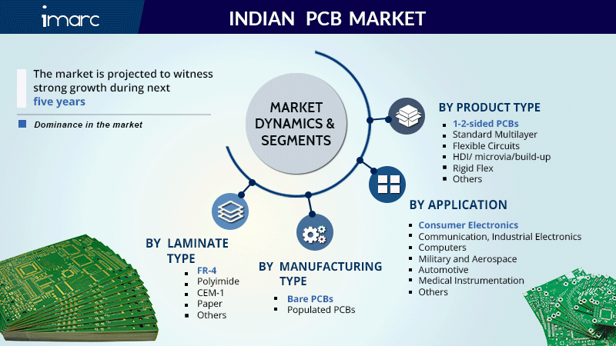

Slide 3
Global Printed Circuit Board Market Outlook and Forecast 2020-2025 - ResearchAndMarkets.com
The Global Printed Circuit Board Market is expected to register a CAGR of 4.12% during the forecast period (2020-2025); it was valued at USD 58.91 billion in 2019, and it is projected to be worth USD 75.72 billion by 2025.
Link

Slide 4
About Field market :
Currently EMS Industry (Contract Manufacturing Services) are valued 832 Bn $ and are projected to grow 1055 Bn by 2025.
Current estimate of EMS Industry in India is USD 23.5 Bn only which is <3% of global mfg. EMS Industry has an estimated 700 Firms with about 600 Indian and 100 Multinational Companies.
China exported US$ 685 Bn of electronics to the world during 2019-20. There is huge export potential for India EMS sector and govt has set a target of US$ 100 Bn exports of mobiles alone by 2025. This is driven by the PLI Scheme and targets about 25% of the global mobile market valued at US$ 415 Bn.
In Non-Mobile segment, China exported electronics worth USD 50Bn to India friendly countries. Government support of 5% will empower Indian EMS sector to capture 30-40% of this, which is USD 15-20 Bn.
Domestic electronics manufacturing is estimated at USD 75 Bn of which 39 Bn constitutes EMS value. This is divided into 23.5 Bn domestic Mfg. and USD 15.5 Bn PCBS/Sub-Assembly imports.

Slide 5
Further USD 53.5 Bn is finished Electronic Goods imports of which USD 17 Bn is EMS value. Thus total EMS opportunity loss is US$ 32.5 Bn (15.5 +17).
We estimate that EMS production can grow realistically from USD 23.5 Bn today to USD 152 Bn by 2025 at CAGR of 45%. This will meet 75% of the countries EMS requirement of US$ 203 Bn by 2025 against a total estimated market of 400 Bn.
The Industry is broadly categorized into HVLM (High Volume Low Mix) which are the large global MNCs and few large Indian Firms and the other category is HMLV (High Mix Low Volume) largely constituted by the Indian EMS Companies catering to lower volume industrial/professional sector products.
HVLM & HMLV have very different characteristics with respect to volume, risk, automation, supply chain, costs etc.

Slide 6
Key challenges faced by the Indian PCB industry
Currently, the output of the Indian PCB industry is less than 1 per cent of the total global market. Major challenges that PCB manufacturers in the country face are:Inefficient supply chain for raw materials
High capex requirements
Lack of access to new technologies and state-of-art manufacturing facilities
Unfair playing field, since companies from competing countries have access to finance at a much lower cost
Logistics inefficiencies and infrastructural bottlenecks, resulting in greater turnaround time and costs
Conflicting policies that are in operation across the various levels within the electronics industry, from the components segment to finished products

Slide 7
Predictions
Printed Circuit Board (PCB) Market Analysis: The Printed Circuit Board (PCB) market revenue was 74083 Million USD in 2019, and will reach 103200 Million USD in 2025, with a CAGR of 5.68% during 2020-2025. A printed circuit board is a provider of electrical connections for electronic components.
Link

Slide 8
PCB manufacturers in the country mostly fall into the following segments:
Large-volume manufacturers (mostly double-sided PCB makers, and a few who produce a good amount of multi-layered PCBs)
Small-volume manufacturers (both double-sided PCB makers and a few who produce multi-layered PCBs)
Small-volume fast-delivery manufacturers (both double-sided PCB makers and a few who produce multi-layered PCBs)
Small-volume complex-design PCB manufacturers
https://www.ipcapcb.org/

Slide 9
Electronic contract manufacturing in India to grow over 6-fold to $152 bn by 2025
This would mean that India would serve 25 per cent of the global mobile market which was estimated to be valued at USD 415 billion in 2025," the statement said, adding that similar support for non-mobile EMS exports would enable India to make a mark in the world market.
electronic-contract-manufacturing-in-india

Slide 10
$152 Bn by 2025: ELCINA report

Slide 11
Competitive Landscape:
The market consists of numerous small and large manufacturers. Some of the leading players operating in the market are:
AT&S
Epitome Components Ltd.
Shogini Technoarts
Cipsa Tech India
Nano Electrotech Pvt Ltd
PCB Power Ltd
Sulakshana Circuits Ltd
Vintek Circuit India Pvt Ltd
Hi-Q Electronics Pvt Ltd
Meena Circuit Pvt Ltd
India Circuit Ltd (Garg Electronics)
indian-pcb-market

Slide 12
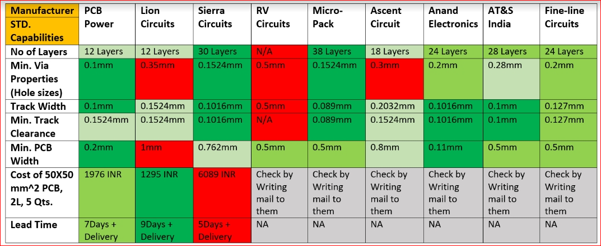
Comparisons of the current manufactures (with respect to specification )

Slide 13
Set up Cost approx
CNC drilling -7L(max fully automated )
PCB cleaning machine (2L)
PCB etching machine (5L)
PCB Grooving Machine (FR- 4) (1.5L)
PCB Brushing Machine(1.85L)
Dry Film Laminator (1L)
Photo Printing Machine(1.6L)

Slide 14
Conclusion 1
High Profit Margins.
Profit margins are important to any business: and most retailers and traditional services-related businesses operate on low profit margins which make it difficult to stay afloat, especially through early years. But PCB printing and manufacturing is well-known for its high profit margins in most cases, and for entrepreneurs who are productivity-oriented, it can be relatively easy to start and successfully operate a highly-profitable startup.

Slide 15
Conclusion
very low capital-output ratio in the PCB industry entails the need for huge investments and high interest costs. Thus, profitability is an issue. Manufacturers are not able to invest in new equipment, most of which is imported.

